Slide 1
Delivering industrial solutions for the fusion research community
Stuart East

Slide 2
Technologies, products and services
Consultancy to the scientific and research community in the definition of achievable requirements for industry
High integrity and multi-discipline engineering & consultancy for construction, assembly, commissioning, maintenance and decommissioning
Specification, design, manufacture & installation of key nuclear components
(eg. nuclear fire dampers, passive fire & biological protection systems, tanks and vessels)
Industrial partnering to support institutions with the delivery of R&D programmes
Industrial and cost efficient solutions for the nuclear waste management and radiological & environmental monitoring solutions
Vertically integrated delivery for high value (EUR 100M+), high risk and complex projects (secondary technologies)
Operations support combining radiological protection & nuclear waste management services

Slide 3
Our Fusion experiences
ITER ORGANIZATION
Value Engineering and Compliance Assessment of the Atmosphere Detritiation Systems
Value Engineering and Compliance Assessment of the Tokamak Nuclear HVAC & LAC’s
Nominated Nuclear HVAC Expert for PDR
Interlock central system study
– Conceptual design and cost estimate of the VV Access and Control System for Assembly
– Detailed Design and Integration of Tritium Plant Building Layout and Sub-systems
DOMESTIC AGENCIES
– Neutronic study framework
– Nuclear Safety studies
– Manufacture, supply & installation of 493 seismic bearing pads for the Tokamak Foundation
INDUSTRIAL PARTNERS
– Cryogenic studies
– Nuclear Safety
Nuclear Quality
– Nuclear Engineer

Slide 4
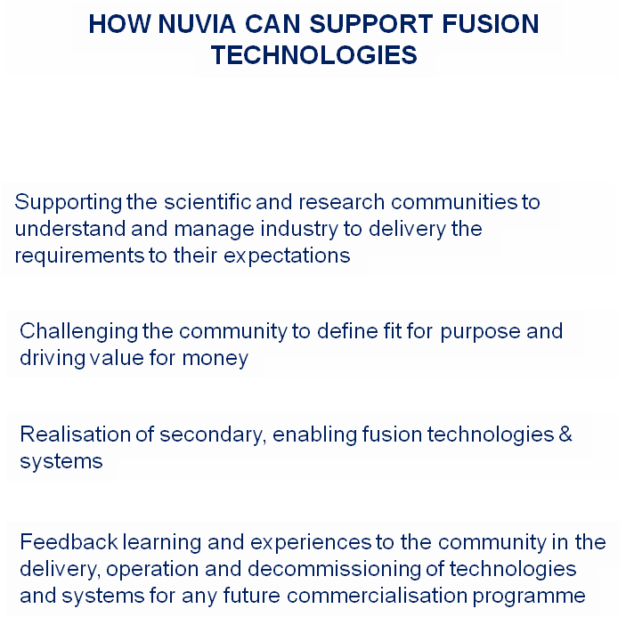
Support and learning from Fusion

Slide 5
Questions
Thank you

