Slide 1
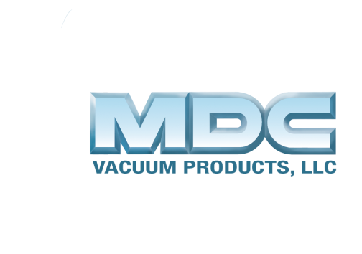
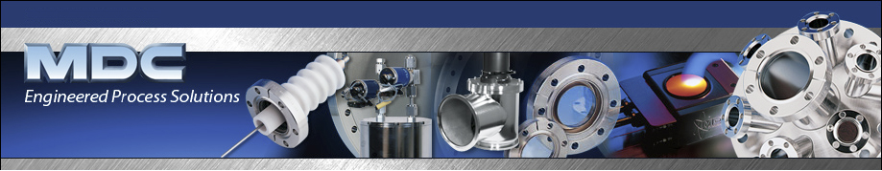
MDC Products & Services Overview
Phil Marston
Technical Support & Sales
MDC Europe
Notes:
Welcome and thank you for your time today.
Introductions of MDC staff present

Slide 2
1 - Technologies & Services
MDC - Manufacturer of standard and custom vacuum components
  Flanges & Components
  Valves
  Manipulation, Sample Transfer, Remote Handling.
  Vacuum Chambers & Custom Fabrications
  Optical Viewports & Anti-Reflective Coatings
  Ceramic Feedthroughs – Custom Designs
    Vacuum to 10⁻¹² mbar / High Pressure to 200bar
    Low Temperature to <4°K / High Temperature to >1000°C
    Single Pin to Multi-pin >100.
ISO 9001:2008 Certified (TUV) at all manufacturing sites
Certifications include ISO, AS 9100, DOT, AWS C5/C5.5M, ASME
ISI is Certified to Appendix B of 10CFR50 Quality Assurance Criteria for Nuclear Power Plants

Slide 3














2 – Some of MDC’s Customers
MDC has developed longstanding relationships with its customers – many are top-tier OEMs and commercial end users
Example MDC OEM and Commercial End User Customers
Account for over 20 yrs | Account for over 20 yrs | Account Since Dec. ‘94 | Account Since Jan. ‘97 | Account for over 20 yrs
Account for over 20 yrs | Account for over 20 yrs | Account for over 20 yrs | Account for over 20 yrs | Account for over 20 yrs
MDC is also a leading provider of vacuum products to national laboratories and major research universities
Example MDC National laboratories and University Customers
AWE Aldermaston | Diamond Light Source | Culham & Harwell | Cavendish Labs
Account for over 20 yrs | Account Since Jan. ’97 | Account Since Oct. ’92 | Account for over 20 yrs | Account Since 2011
Highly diversified customer base ➔ No one customer > 10% of sales

Slide 4
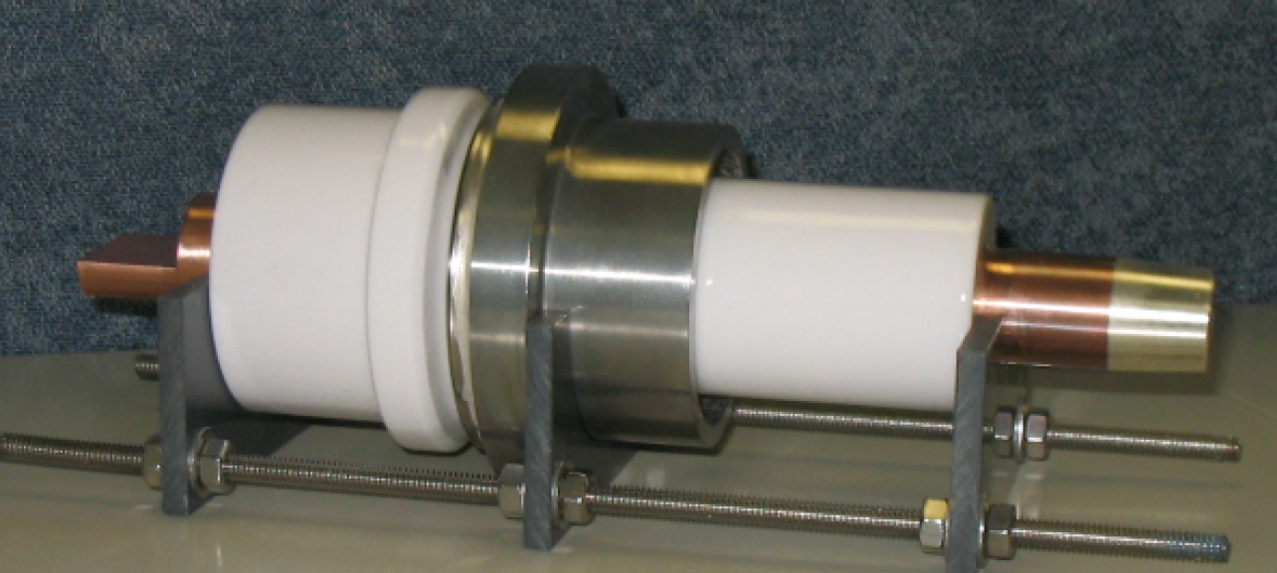
3 - What’s in it for MDC?
New Customers & New Challenges
New Products & Spin off Technologies
  Examples :-
  High Pressure Terminal Gland rated 200bar for Nuclear Plant (Westinghouse AP1000)
  High Temperature Ceramic Breaks (1000°C Fuel Cell)

