Slide 1
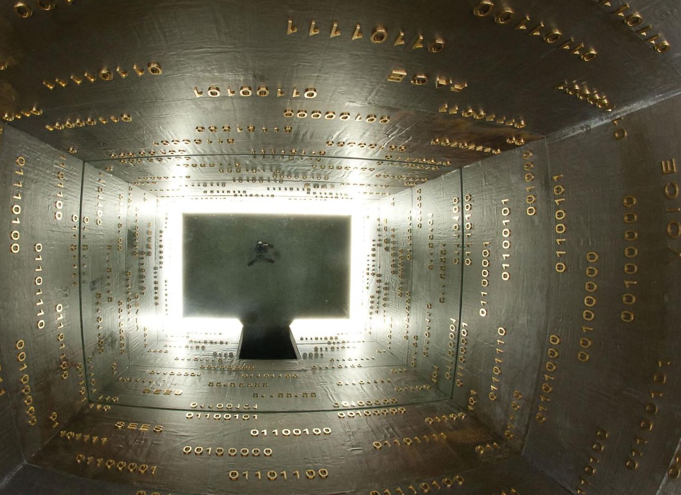
WE ARE WSP
An introduction to WSP Group
May 2012
Scot Parkhurst, Energy Sector Director
Notes:
IMAGE: The Museum of Old and New Art (MONA), Hobart Australia. Artist: Brigita Ozolins, Lighting: WSP Vision Design

Slide 2
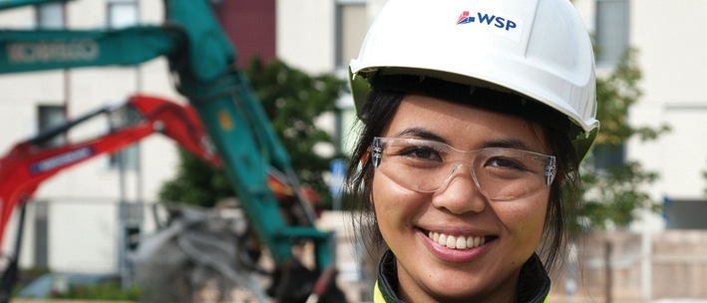
WE ARE WSP
ABOUT US
AOUT US
60
WE HAVE PROJECTS IN 60 COUNTRIES
WSP IS ONE OF THE WORLD’S LEADING ENGINEERING AND DESIGN CONSULTANCIES. WE PROVIDE SUSTAINABLE CONSULTING TO THE BUILT AND NATURAL ENVIRONMENT. THIS INVOLVES DESIGNING, ENGINEERING AND MANAGING PROPERTY, TRANSPORT, INFRASTRUCTURE, INDUSTRIAL, ENVIRONMENTAL AND ENERGY PROJECTS.
Notes:
IMAGE: Anu Tran-Haverinen, Ground Engineering, Helsinki. Taken by Nicola Evans, WSP

Slide 3
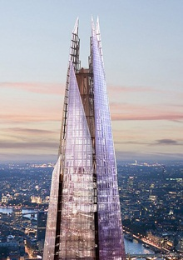
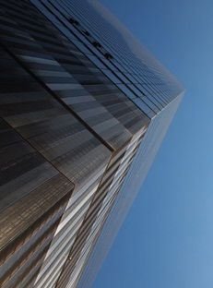
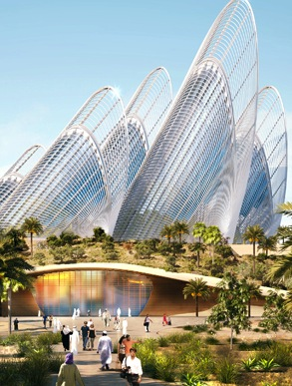
OUR PROJECTS ICONIC PROJECTS WORLDWIDE
£717M
2011 REVENUE
c.9000
GLOBAL WSP EMPLOYEES
PROJECTS
The Shard at London Bridge
World Trade Center, New York
Zayed National Museum, Abu Dhabi
Notes:
One World Trade Center 540m. 104 floors. America's tallest building
Shard. 310m 76 floors. EU tallest building

Slide 4
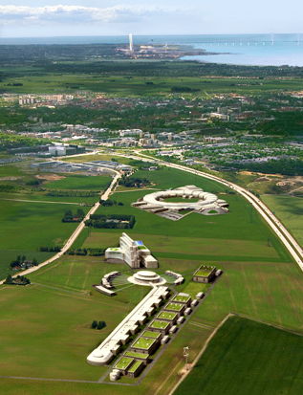
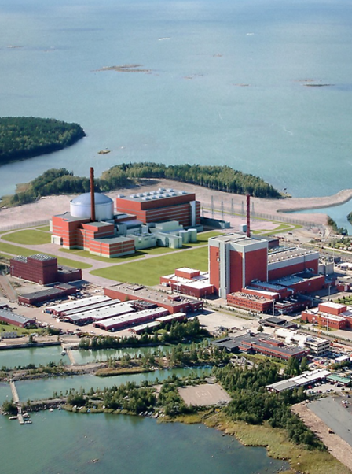
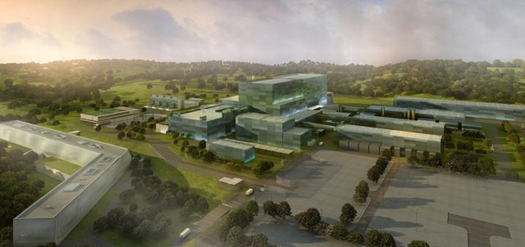
OUR PROJECTS ENERGY
PROJECTS
ESS Project, Sweden
Olkiluoto 3, Finalnd
ITER, France

Slide 5
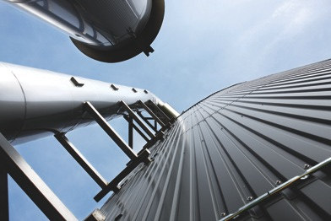
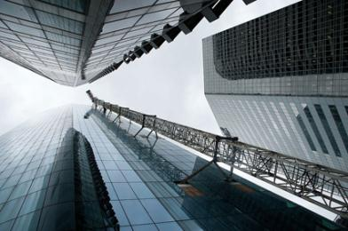
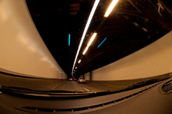
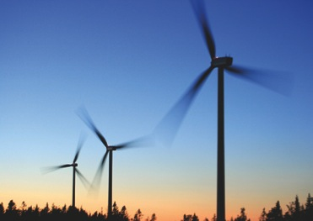
FUTURE ENGINEERING
ITER & DEMO
DEVELOPMENT
PROPERTY
TRANSPORT
INFRASTRUCTURE
ENVIRONMENT
SUSTAINABILTY
MANAGEMENT
ABOUT US
Image courtesy of
Jeannette Hägglund
CORE SERVICE PROVISION
SPECIALIST TECHNICAL SKILLS
Optioneering and optimisation
Risk management – design & buildability related
Complex structural engineering
4
3
1
2
Notes:
OneOneOne, 77 Eagle Street, Brisbane/Driving in Sydney/Regional Anaerobic Digestion Plant, Sundsvall, Sweden/image courtesy of Stena Renewable

