Slide 1
TWI - a brief introduction
Prof Sayee Raghunathan
Associate Director

Slide 2
Content
Introduction to TWI
TWI Fusion RD&D

Slide 3
TWI Group
World-class provider of
engineering, materials and
joining technologies
Maintain and
develop TWI brand
reputation to add value
to members
Leading international
training and examination
product
UK professional
engineering
institution

Slide 4
Global Membership base
UK
China
South
Korea
Bahrain
Iran
Japan
Houston
UAE
Thailand
Taiwan
India
Vietnam
Malaysia
Indonesia
Brazil
750 members in 2500 locations in >70 countries
Notes:
Blue – members exist currently, red- where TWI has offices et al.
Stete memebsr pay annual fees to access knowledge, info and services (contract)

Slide 5
Relationship with members
Understand: Challenges and how we can help
Add value: Integrated multidisciplinary solutions to deliver quality, Impartial and confidential
Commitment: Investing funds to provide innovative solutions to integrate and enhance members operations
Engagement: One to one interactions, Research board, Industry panels, TWI Council, etc…
Coverage: Global presence
Proof: Our achievements as well as position in the industry

Slide 6
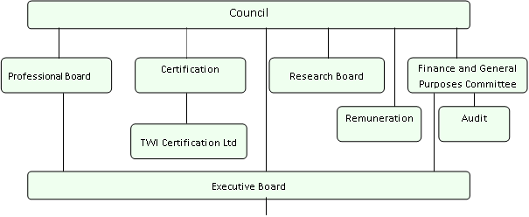
Corporate Governance
TWI Group Companies
The Welding Institute TWI Middle East
TWI Ltd TWI Persia
TW Certification Ltd TWI North America
TWI Technology Centre (North East) TWI Training and Certification (S E Asia)
TWI Technology Centre (Yorkshire) The Test House (Cambridge) Ltd
TWI Technology Centre (Wales) Plant Integrity Ltd
TWI Technology Ltd

Slide 7
TWI Innovation and funding
Ecosystem
Government/public funding
Contracts from members
Membership fees and profits
Collaborative
SCP
CRP
GSP
Business
Centre
Innovation
Centre
Exploratory research
Codes and standards
New Products
Information and knowledge dissemination
Licensing
License fees
Funding flow
Membership fees
Innovation flow
Non – profit distributing
Service flow

Slide 8
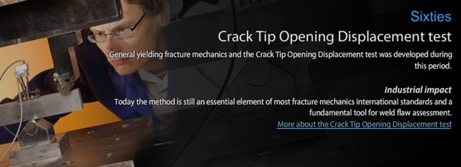
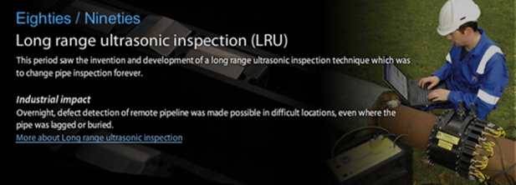
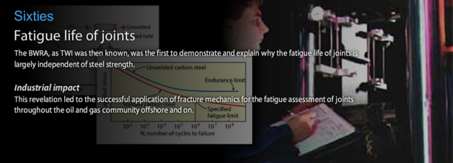
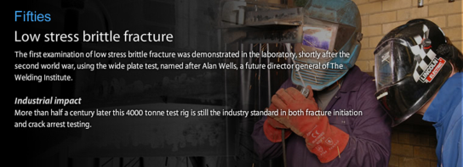
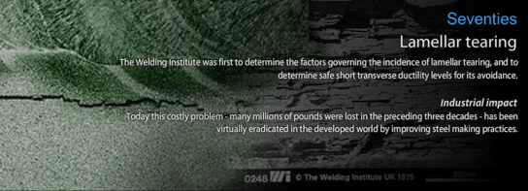
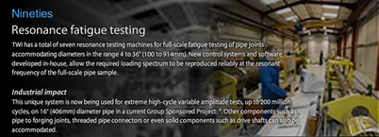
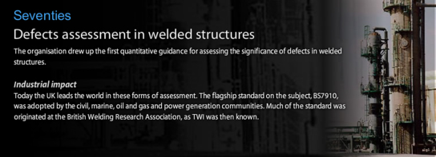
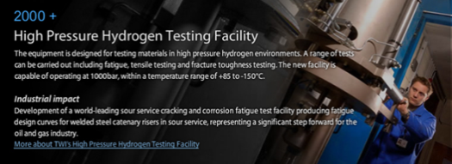
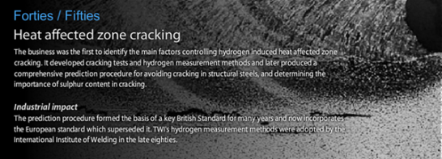
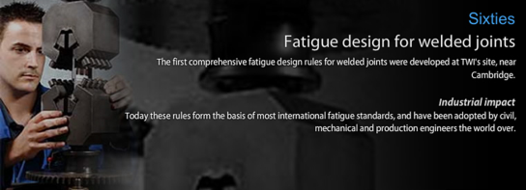
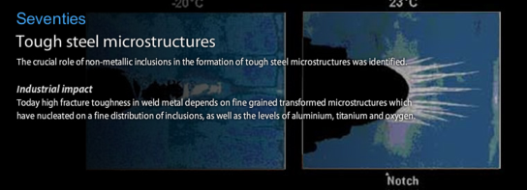
Innovation Timeline
Weld behaviour and testing
1923
Forty’s
Sixty’s
Seventy’s
2000+
Fifty’s
Eighty’s to ninety’s

Slide 9
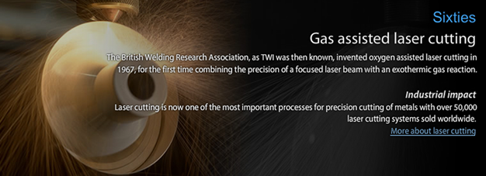
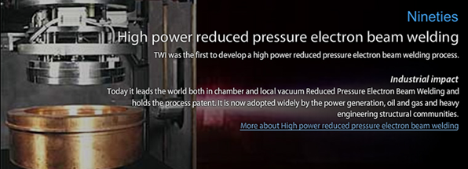
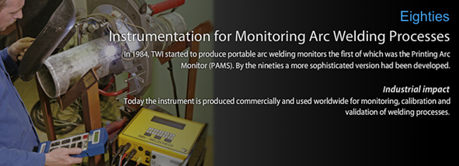
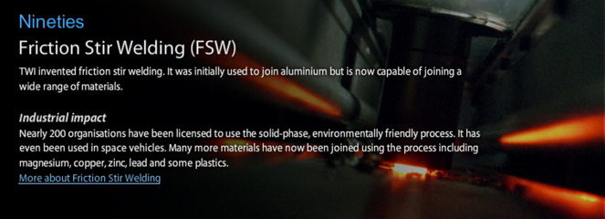
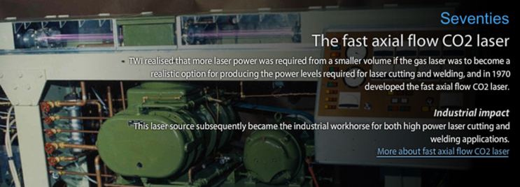
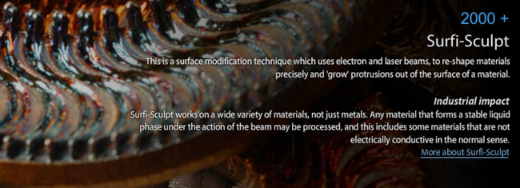
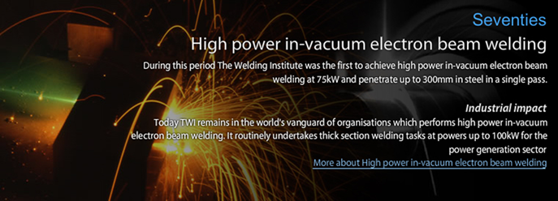
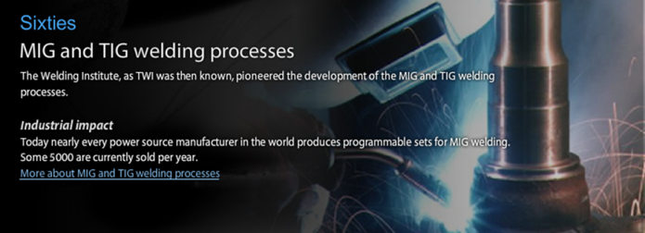
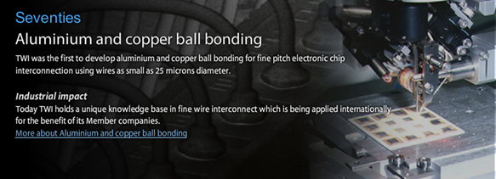
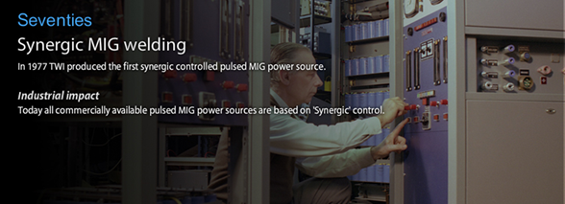
Innovation Timeline
Weld Processes
1923
Sixty’s
Seventy’s
Eighty’s to ninety’s

Slide 10
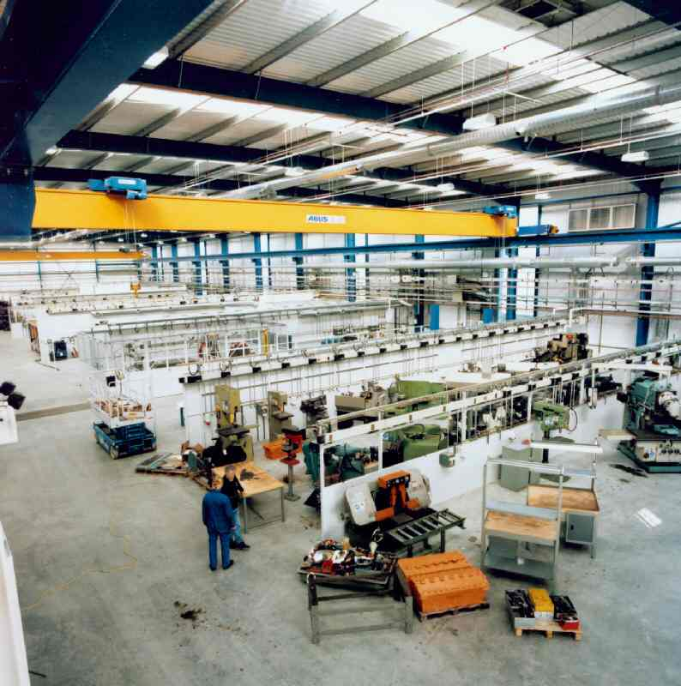
TWI today
State of Art Engineering Facilities
Arc, EB, Friction, Laser welding & processing
Additive manufacture
NDT centre
Surfacing laboratory
Creep, fatigue, fracture & corrosion testing labs
Structural Integrity
Large & small scale testing
Metallography
Composites
Harsh environment testing

Slide 11
Comprehensive support
Remaining life / life extension
Materials/process selection and ECAs
Decommission
Pre/FEED
Structural Integrity
Materials
NDT
Welding and Fabrication
Failures
Fabrication
Analysis/
Litigation
WEnrg
/qualifcation
Performance
Specifics
AIM/Inspection/FFs assessments/ECA
Testing/ beyond standards
Installation
Materials behaviour

Slide 12
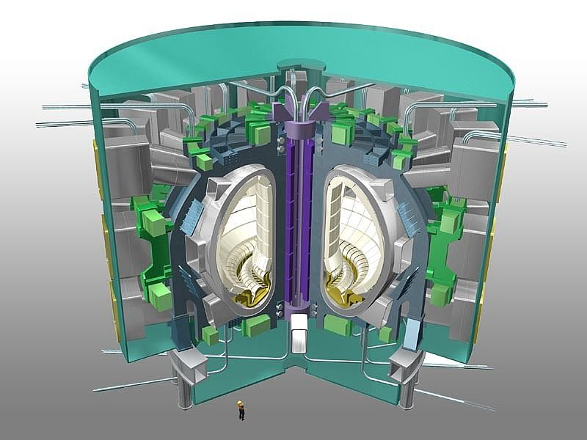
Fusion Project Support
Development of EB welding to join toroid sections
Dissimilar metal & ceramic/metal joining
F4E welding & NDT technical support
Collaboration with Members to bid for ITER fabrication packages

Slide 13
Fusion
Priority Themes and Hot Topics
Codes and Standards
AFCEN RCC(MR)
Inspection
Irradiated steels - welding
Joining technology R&D
Coating

Slide 14


F4E Framework Proposal
Provision of engineering support on Joining and Non-Destructive Testing Technologies for production of ITER Components

Slide 15
F4E Framework Proposal F4E-OPE-149
Scope
  performance of materials
  joining
  structural integrity of joints
  non-destructive testing activities
To support the manufacturing of the structural components of ITER, for eg
  vacuum vessel, magnet system, remote handling and in-vessel components

Slide 16
Key highlights
framework service contract designed to set the legal, financial, technical and administrative terms governing relations between TWI and F4E during the contract term and does not constitute placement of an order
Estimated value excluding VAT: €800,000
Duration: 4 years
Agreed manhour and equipment rates, hourly, weekly and monthly rates

