Slide 1
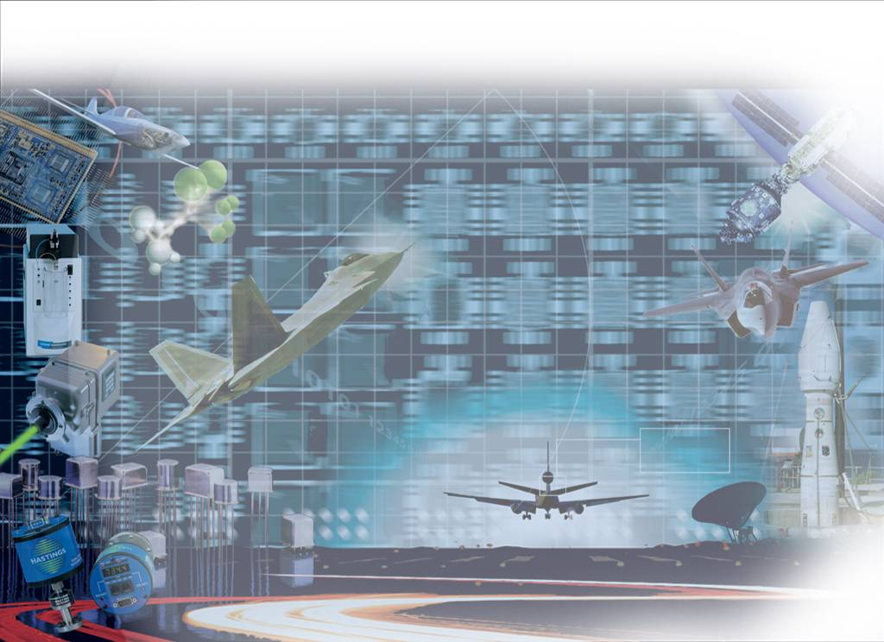

Capabilities Brief

Slide 2
Corporate Overview
Head Office: L.A California
Employees: 9000
Turnover $2Bn
Regional Offices: 52 Global (UK 10)
Divisional Structure:
  Instrumentation
  Aerospace & Defence
  Digital Imaging
  Engineering Systems

Slide 3
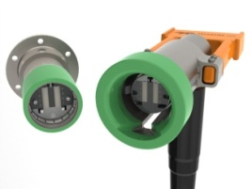
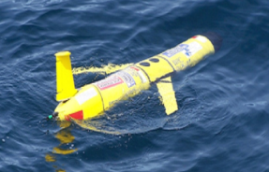
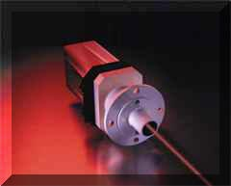
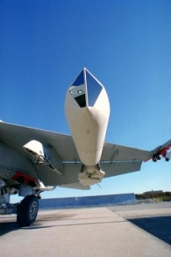
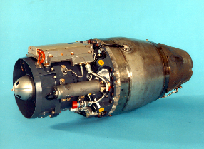
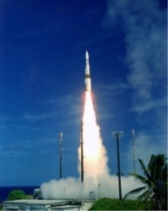
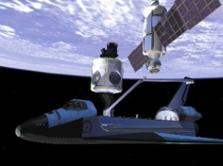
Business Divisions
Aerospace/Defense
35%
32%
Instrumentation
Systems
15%
Engineering Systems
Energy Power Systems

Slide 4
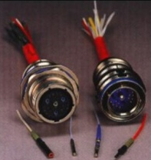

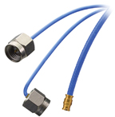

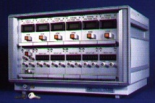
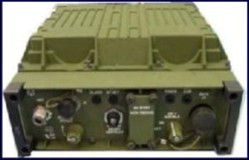
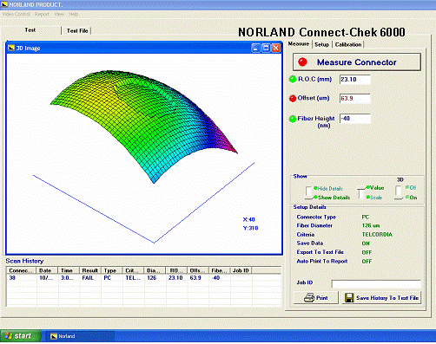
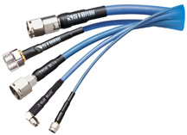
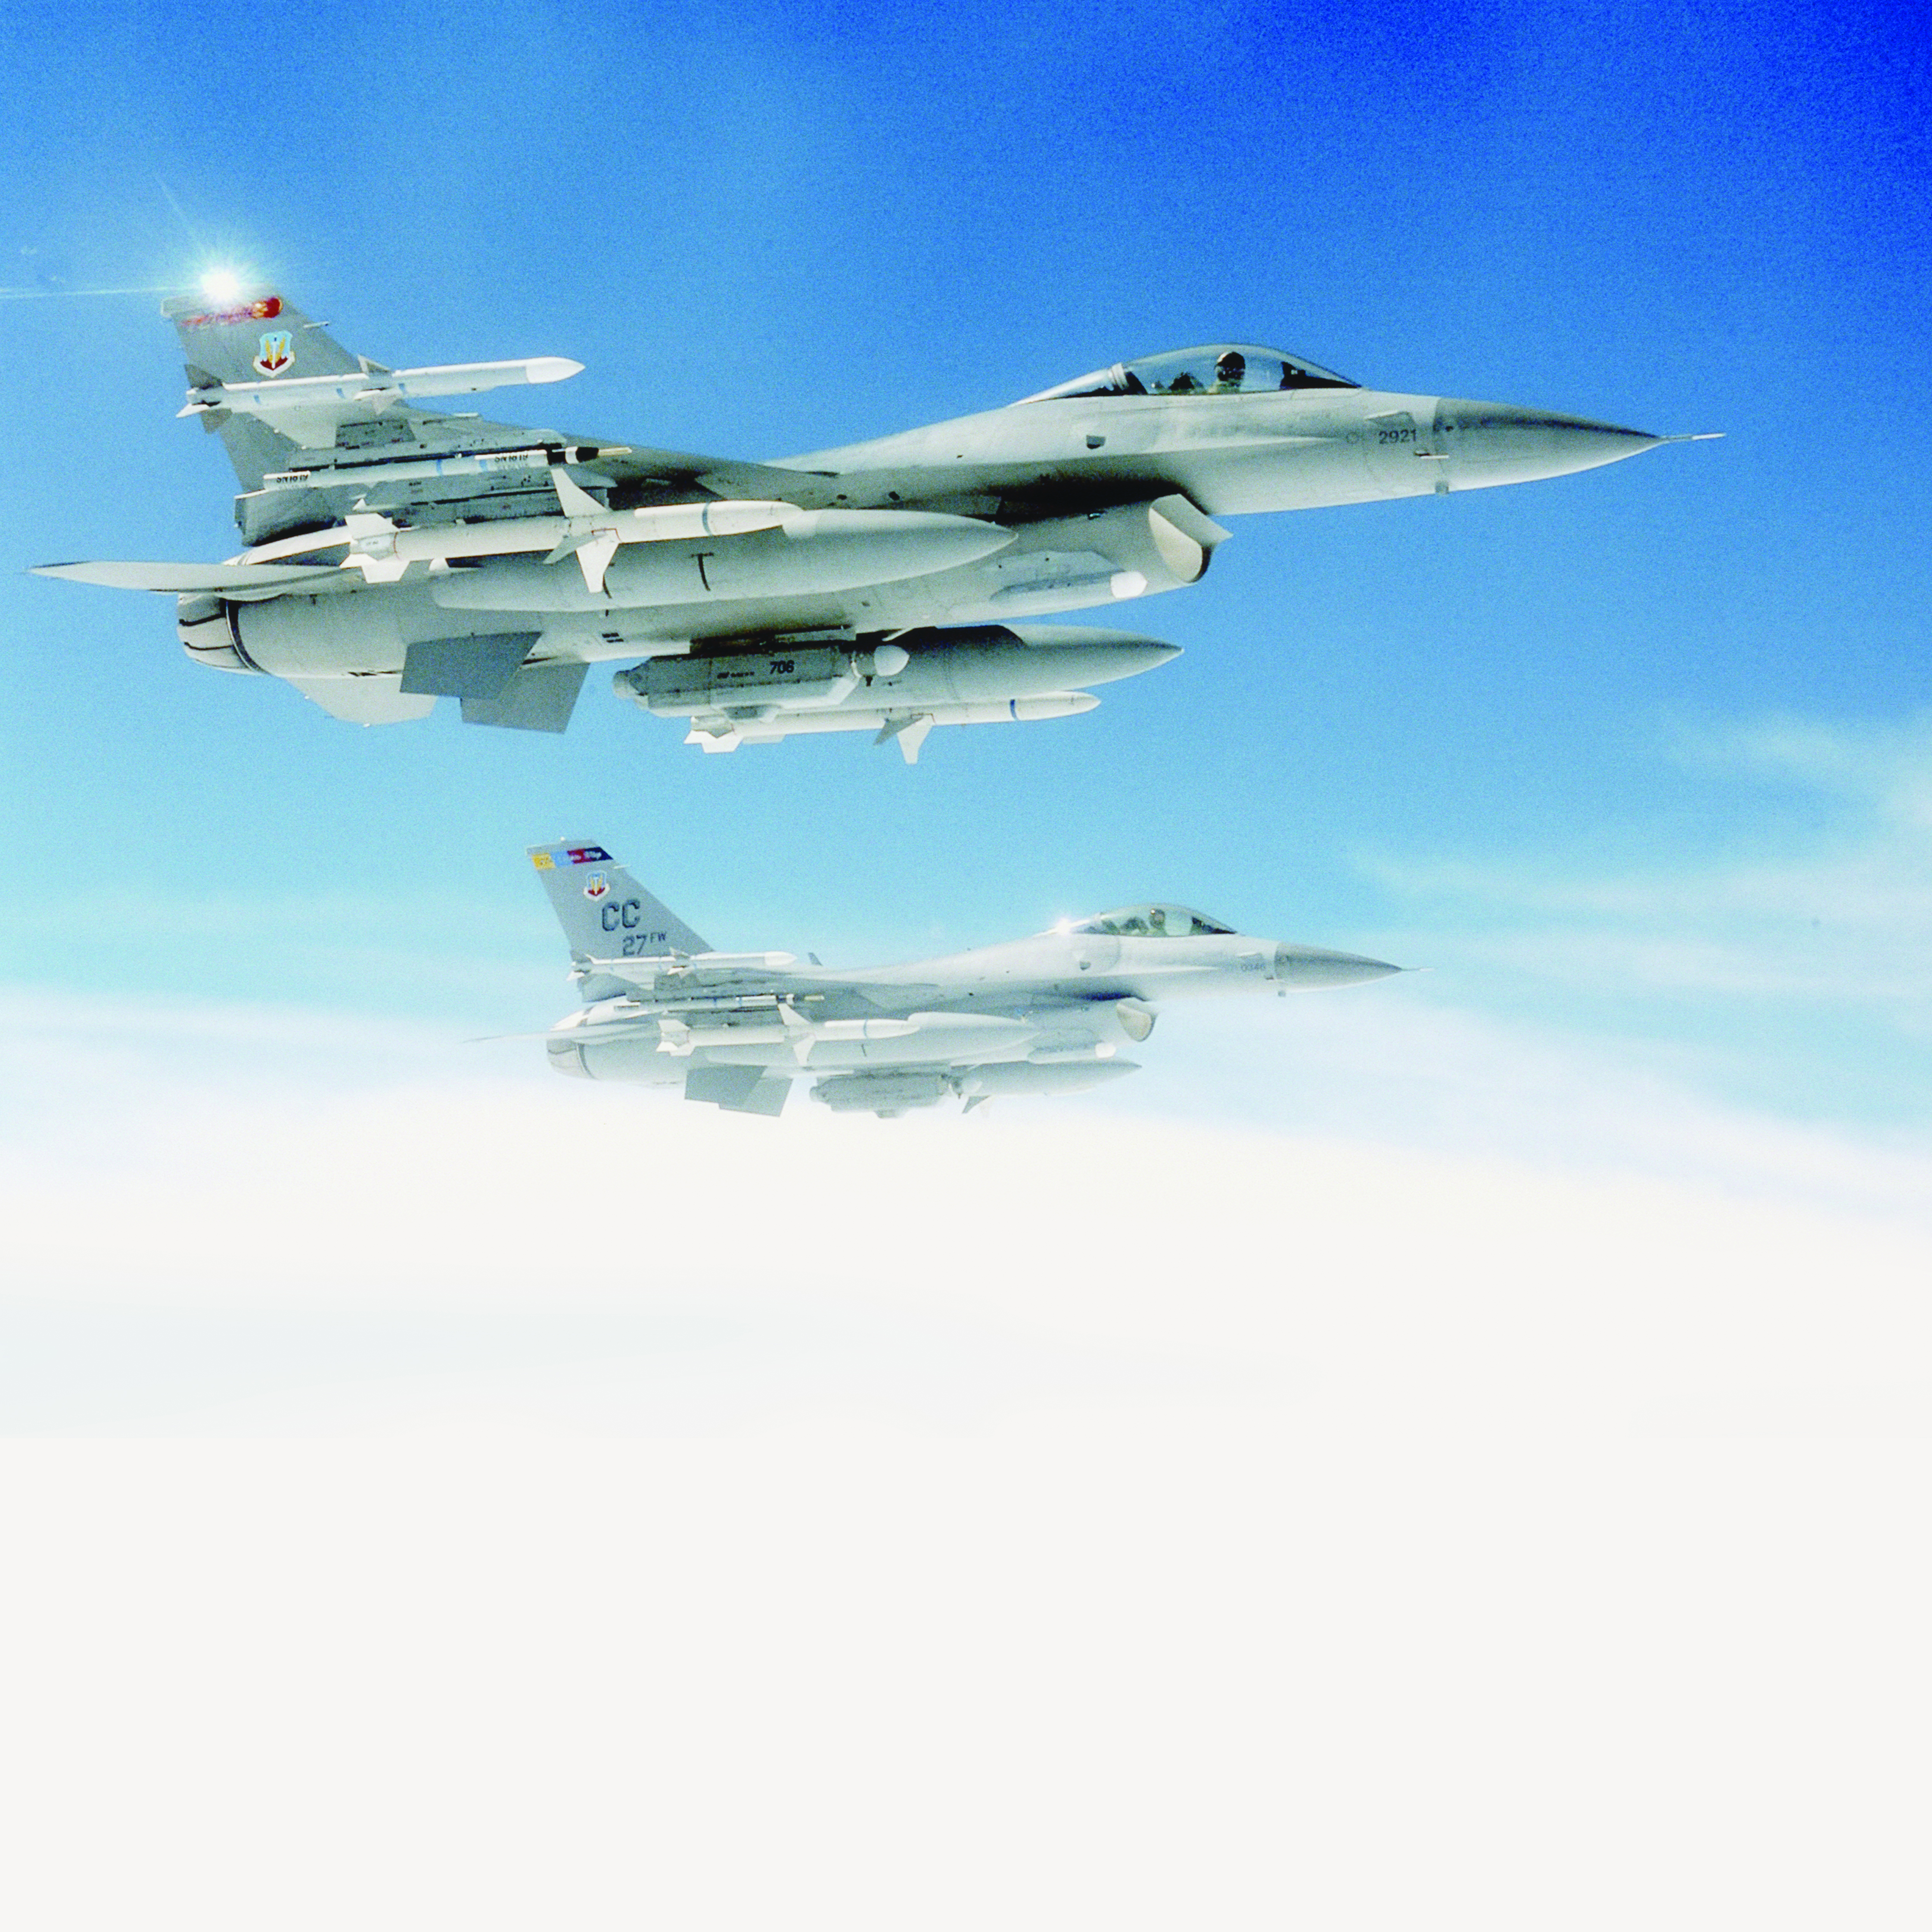

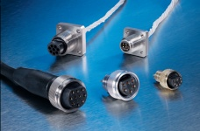
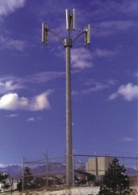
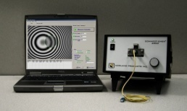
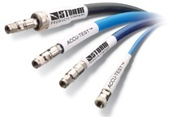
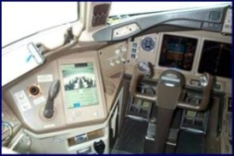
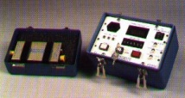
Facilities & Products
Two Facilities, Newbury (24,000 ft²) & Cwmbran (5,500 ft²)
Six Technology Based Product Groups
High Voltage
Cable & Wire Connectors Spark Gaps Capacitors Assemblies
Fibre Optic
Cable Connectors Assemblies
Microwave
Flexible Semi Rigid RG Style
Defence & Avionic Systems
Airborne Pods Pilot Controls HMD Umbilicals Head Trackers PCB Assembly
Initiation & Ordnance
Fire Sets Detonators SAFU Break Up Unit Security Armour
Custom Interconnects
DC Power Sub Systems Box / Rack LV Harness Loom assys

Slide 5
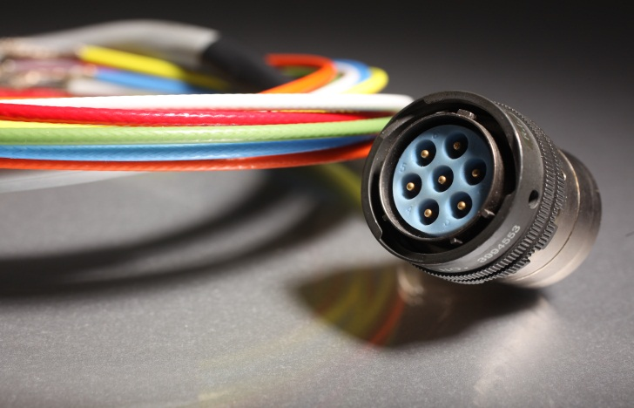
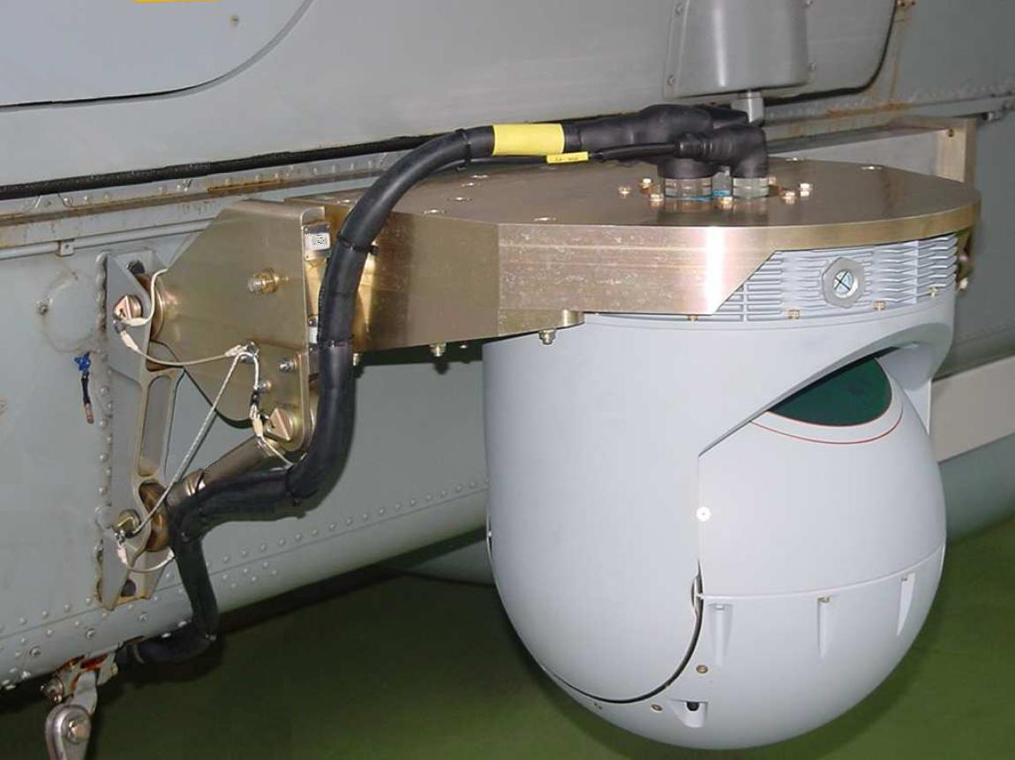
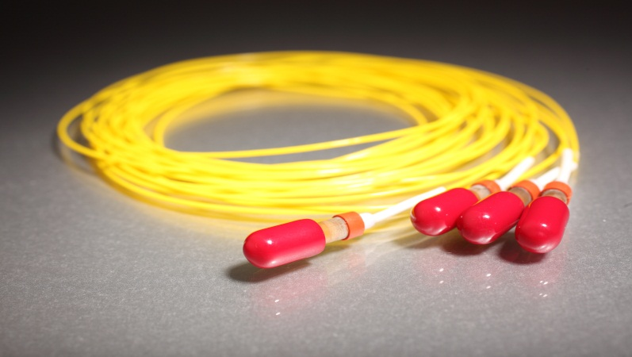
Cable Assembly +
Design, manufacture and test
  HV
  LV
  Fibre Optics
  Harnessing, Looms
  Electro-mechanical
  PCB Design
  Box Build

Slide 6
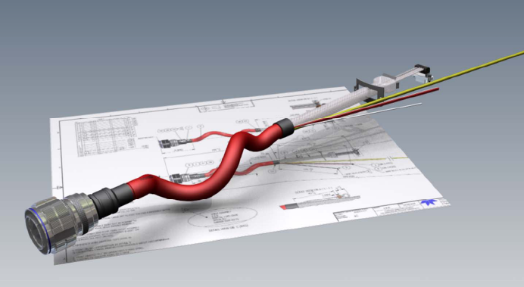
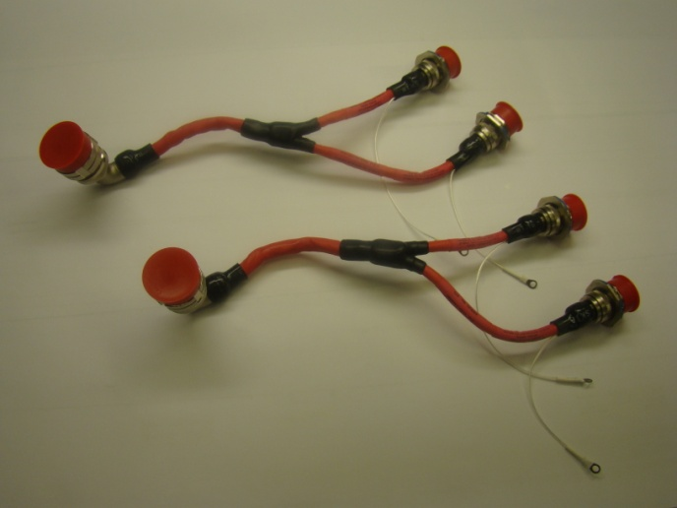
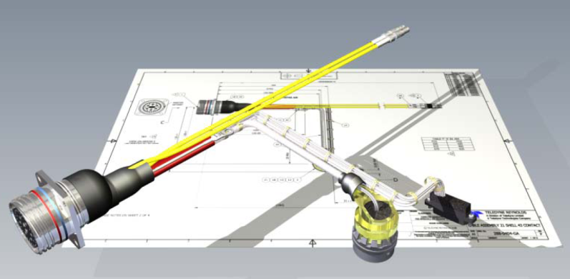
Custom Products
Cables, Connectors & Assemblies
High voltage cable supply
High voltage cable assembly
Harness and loom design and manufacture
Design and rapid prototyping
Microwave cable assemblies
RF cable assemblies
Fibre optic cable assemblies
Cable assembly repair & overhaul
Electro-mechanical assemblies
Electronic assembly wiring and test

Slide 7
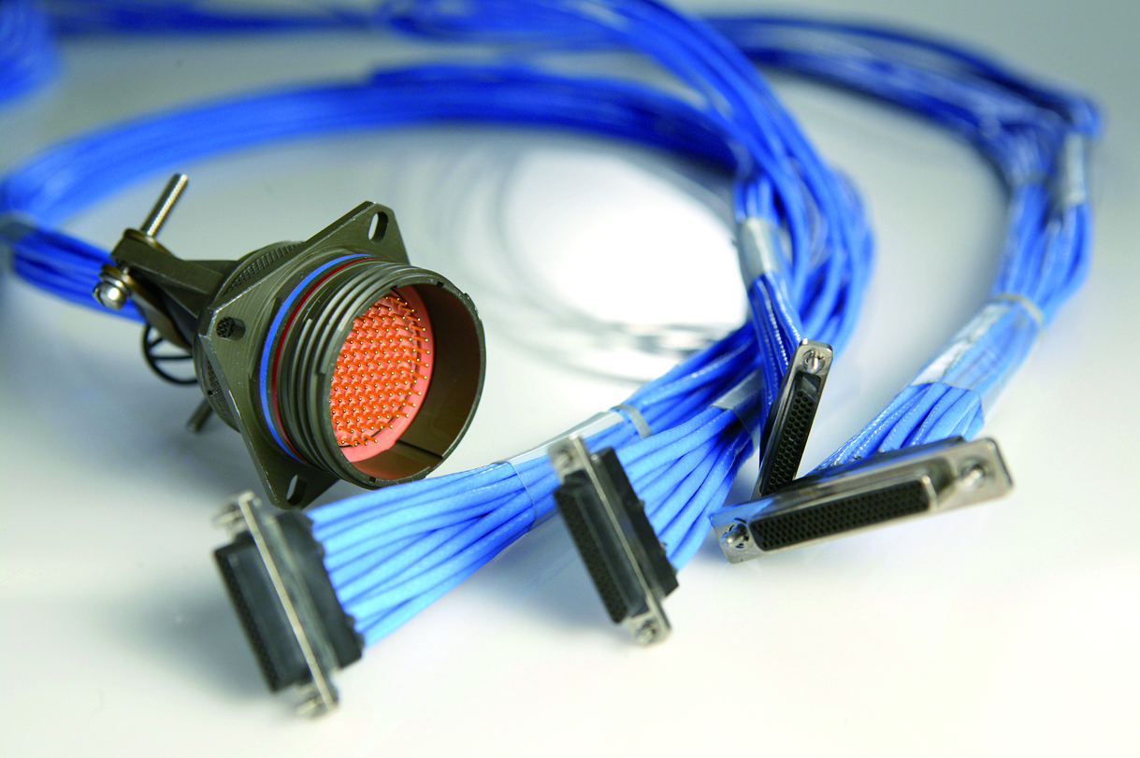
Skills and Capabilities
Design, manufacture and test :
High Voltage & RF Test capabilities
All staff trained to IPC620 standards.
4 ESA Trained & Certificated Wiremen
30 Skilled Assembly Operators
Separate RMA Facility
  Dedicated Repair personnel
Value Add
Next Level Assembly
Project Management
Dedicated Production Engineering Support
Site Visit to support design, prototyping and First Off fit

Slide 8
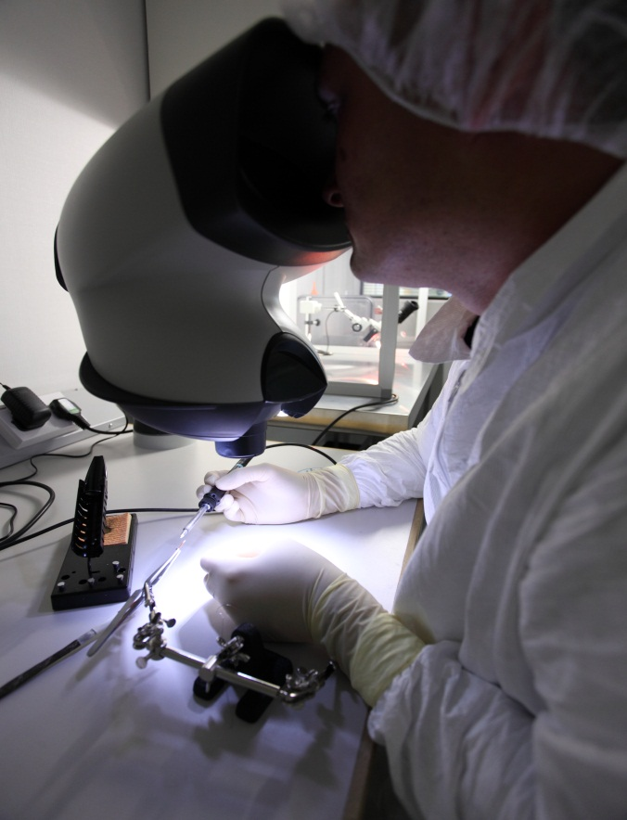
Equipment
Equipment List
  Clean Room
  EPA (Electro-Static Protected Area)
  25 Soldering Stations
  Automated Wire Strip
  Abrading & Etching Equipment
  Potting Facility
  Fibre Optic Stripping, Bonding & Polishing
Specialist Inspection
  Sectioning Equipment
  Optical Video Measuring System
  Pull & Compression Test Equipment
Test Equipment
  Three High Voltage Altitude & Temperature Testing Chambers
  Corona testing station (sea level)
  Helium Leak Test
  In Process Automatic Low Voltage Multifunction Testing
  Vector Network Analyser (10MHz to 50GHz)
  Fibre Optic Interferometery, TDR and Insertion Loss

Slide 9








Key Customers
A Highly Respected Customer Base
AWE
Alcatel-Lucent
UK Ministry of Defence
BAE Systems
Selex Sensors and Airborne Systems
SAAB Defence Group, Sweden
Selex Galileo (UK & Italy)
Thales Group (UK and France)
Nokia & Ericsson (Sweden and Denmark)
Tyco Group (Poland, China, India)

Slide 10
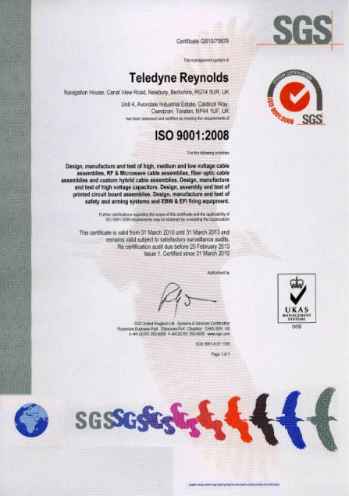
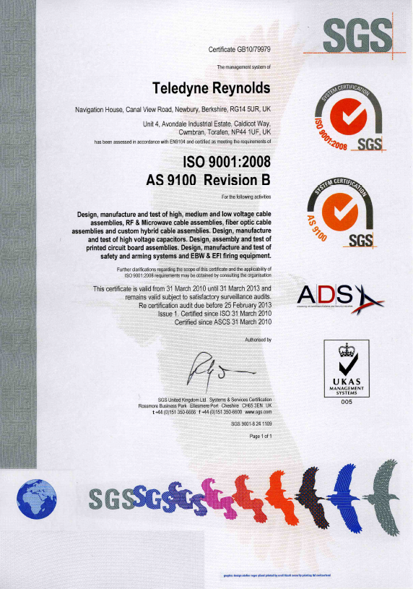
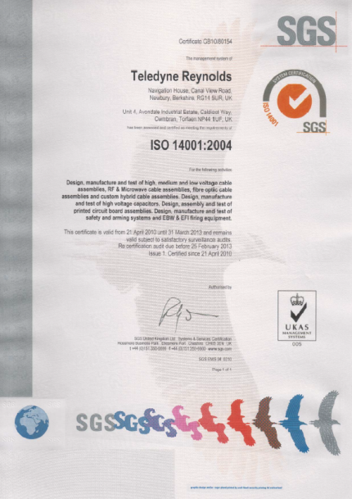
Quality Approvals
Highest Accreditations
  AS 9100 : 2008
  ISO 9001 : 2008
  ISO 14001 :2004
Continual Improvement
  SC21 Certification
  DAOS Approval
Notes:
10

Slide 11
Strategy for Fusion
Forward
Engage with Fusion Industry and associated partners.
Develop an awareness of Teledyne Reynolds Capabilities
Leverage Teledyne’s areas of expertise (mil, defence & space heritage)
Achieve multi level supplier status within a tiered supplier chain
Establish Teledyne Reynolds the Industries choice for system interconnect
Foster and develop long term relationships with key sites (UK, France & Spain)

Slide 12

Summary
What Can Teledyne Reynolds bring to the Fusion Industry?
A Partnership Which Provides:
Choice & Flexibility
Localised Manufacturing
Leading Edge Technologies
Highly Skilled Manufacture & Test
Reduction in Non-Core Activities
Associated Cost Benefits
Cooperative Development

Slide 13
Thank you!
Contact ;
Martin Hodges
Sales & Marketing Manager
Tel +44 (0) 1635 262231
E-mail : mhodges@teledyne.com

