Slide 1
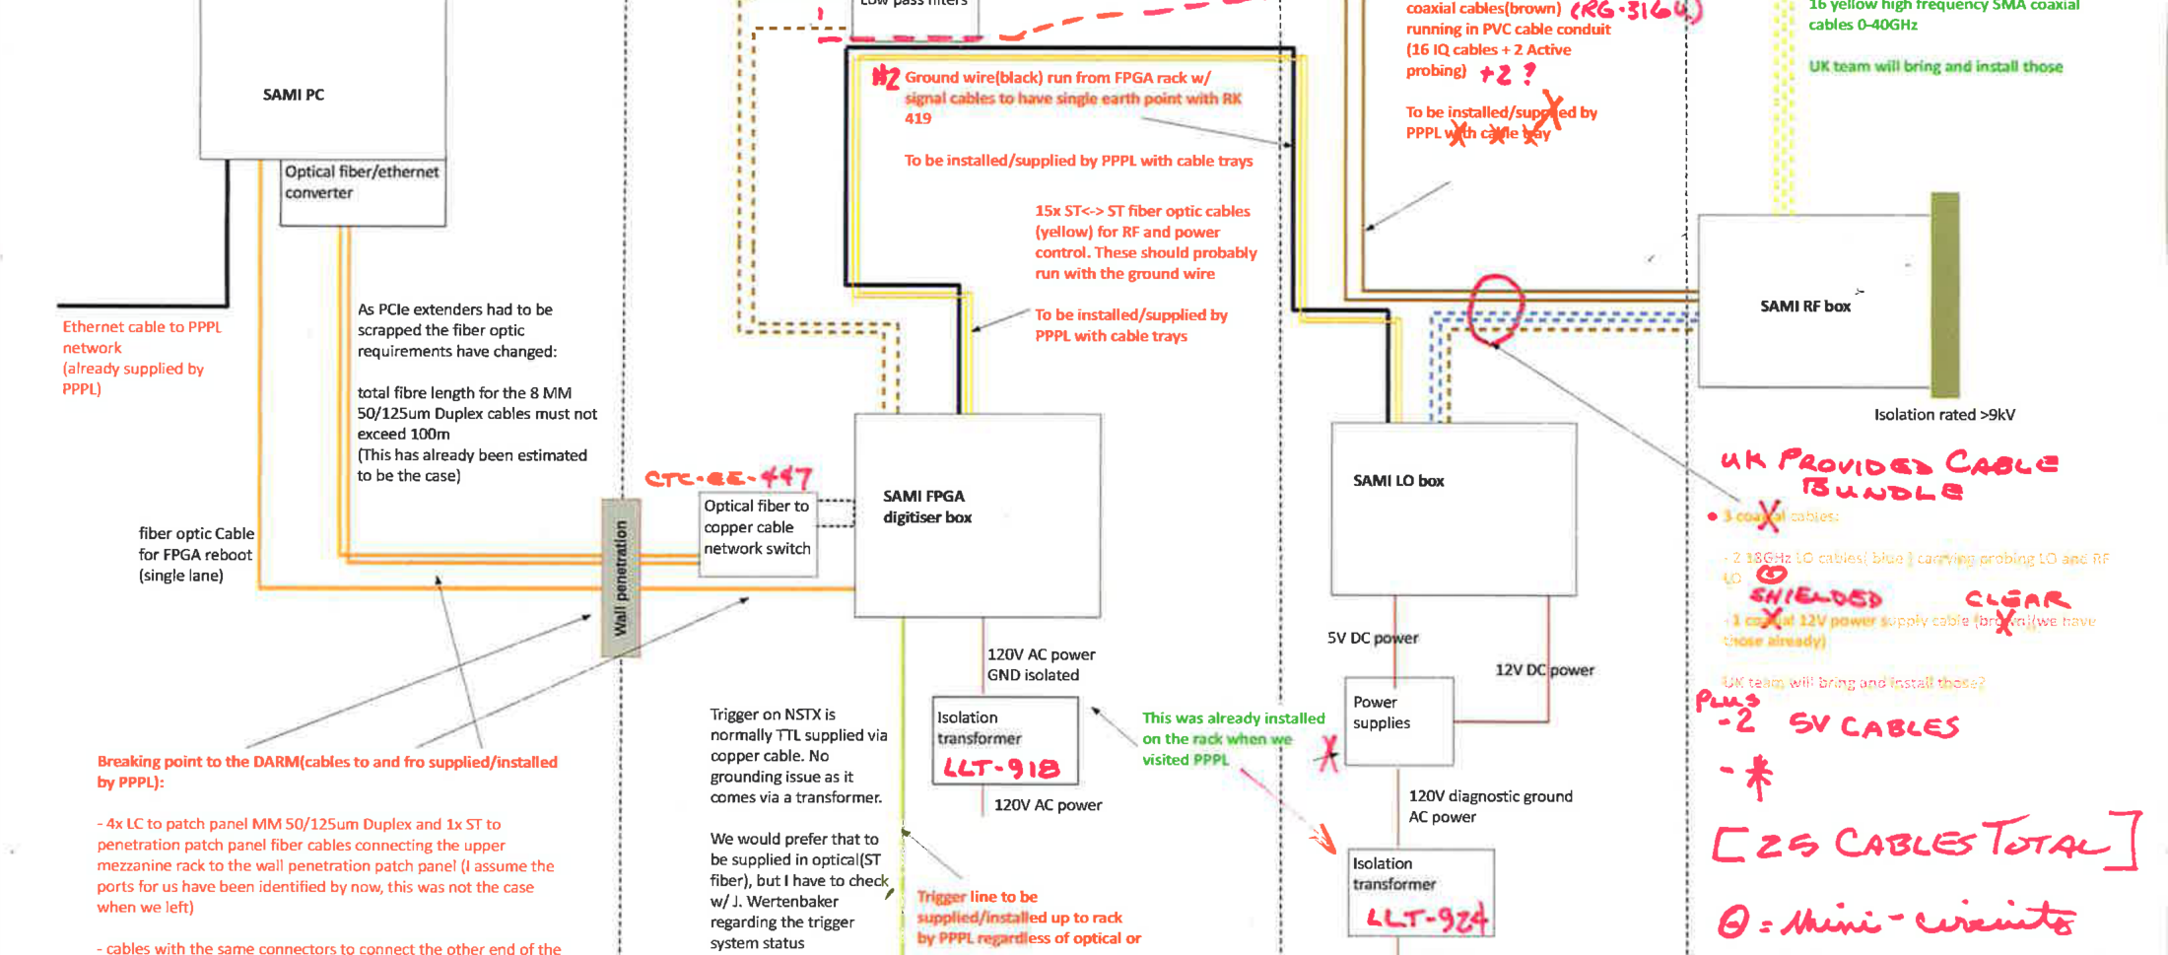
SAMI @ NSTX-U
Incident in April delayed operations until October
Due to manpower issues, SAMI will not be commissioned until November
MAST-U design review for SAMI on 16 October

Slide 2
SAMI: science outputs
Dave Thomas’ Nucl. Fusion paper has come back from referees with only minor corrections required (see right)
Very recent work from Jo Chorley (Durham) has shown: [ECE power] ~ [Da power] exp(-L_{n}/const) This is important for determining importance of collisional damping of microwave signals and thence interpretation of SAMI data

